Slide 1
Uni
cever
Empowering Trust Through UNICEVER - Your Open-Source Solution for Secure Certificate Verification
Rajarshi Samaddar – 24400120030
Prateek Kumar – 24400120009
Md Danish Raja – 24400120012
Soumayadip Saha – 24400120037
Project Mentor – Mr. Samik Datta

Slide 2
Table of Contents
01 | Overview | 02 | Objective
03 | Domain | 04 | Tech Stack
05 | HLD Architecture | 06 | Login / Sign-up
07 | Create Certification Events | 08 | Manage Certification Events
09 | Certificate Issuance | 10 | Future Scopes
11 | Benefits and Outcomes | 12 | Conclusion
Uni
cever

Slide 3
Project Overview
Uni
cever
Trustworthy Certificates: UNICEVER delivers secure, authentic certificates for educational institutions and organizations.
Effortless Verification: Unique codes embedded in certificates enable easy online verification, ensuring integrity.
Open-Source Innovation: Built on open-source principles, UNICEVER combines collaboration and security for a new standard in certificate validation.

Slide 4
Project Objective
Enhance Authenticity: Develop an open-source tool that ensures the legitimacy of digital certificates, addressing the challenge of forgery and counterfeiting.
Streamline Verification: Create an automated verification process using unique codes, simplifying certificate validation for recipients and organizations.
Promote Transparency: Foster transparency and trust by providing organizations with a secure, open platform for issuing and verifying credentials.
Uni
cever

Slide 5
Project Domain
Secure Verification: Developing secure methods to authenticate digital certificates, guarding against fraud and tampering.
Efficient Validation: Creating efficient automated processes for certifying the legitimacy of credentials.
Trust Enhancement: Promoting credibility and transparency in digital certifications for increased trust among issuers and recipients.
Uni
cever

Slide 6
Tech Stack
Next. js
Redux Toolkit
TypeScript
PostgreSQL
Material UI
Auth0
Vercel and GitHub
Uni
cever

Slide 7
HLD Architecture
Login / Sign-up
Dashboard
Create event / course
Manage event / course
Uni
cever

Slide 8
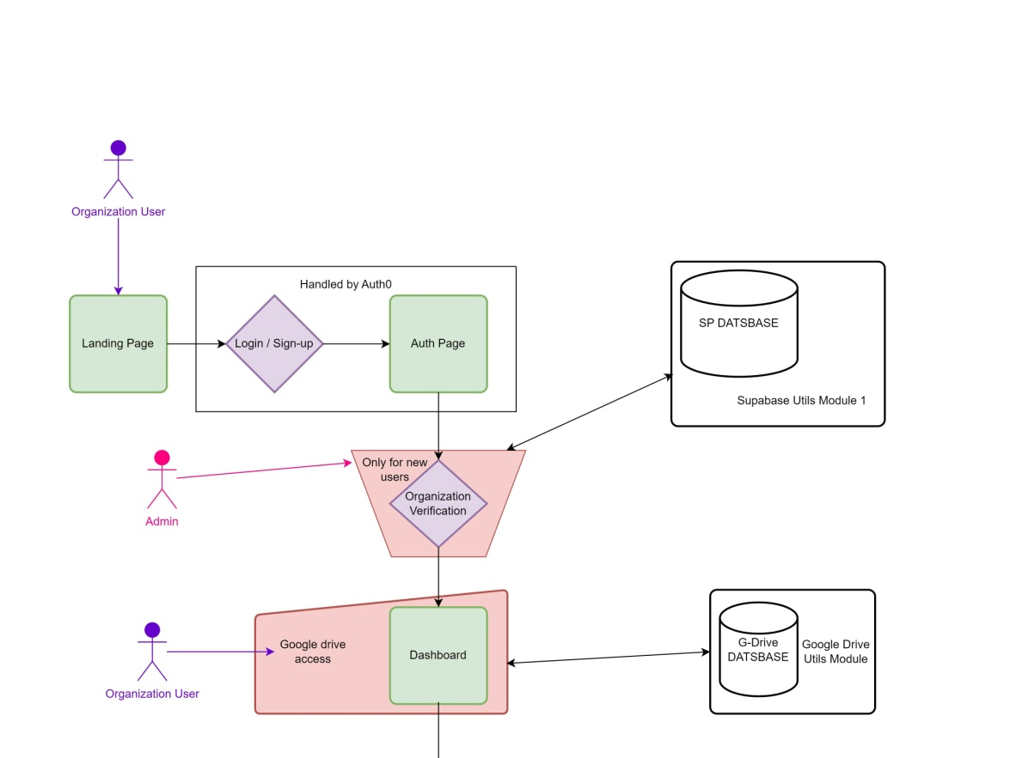
Login or Sign-up
Uni
cever

Slide 9
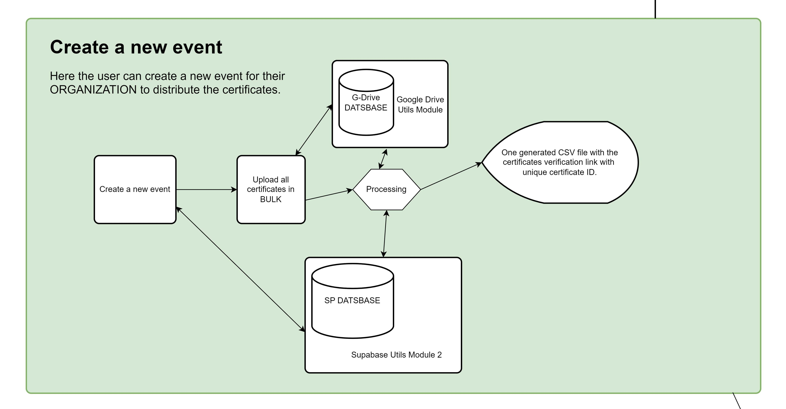
Create Certification Events
Uni
cever

Slide 10
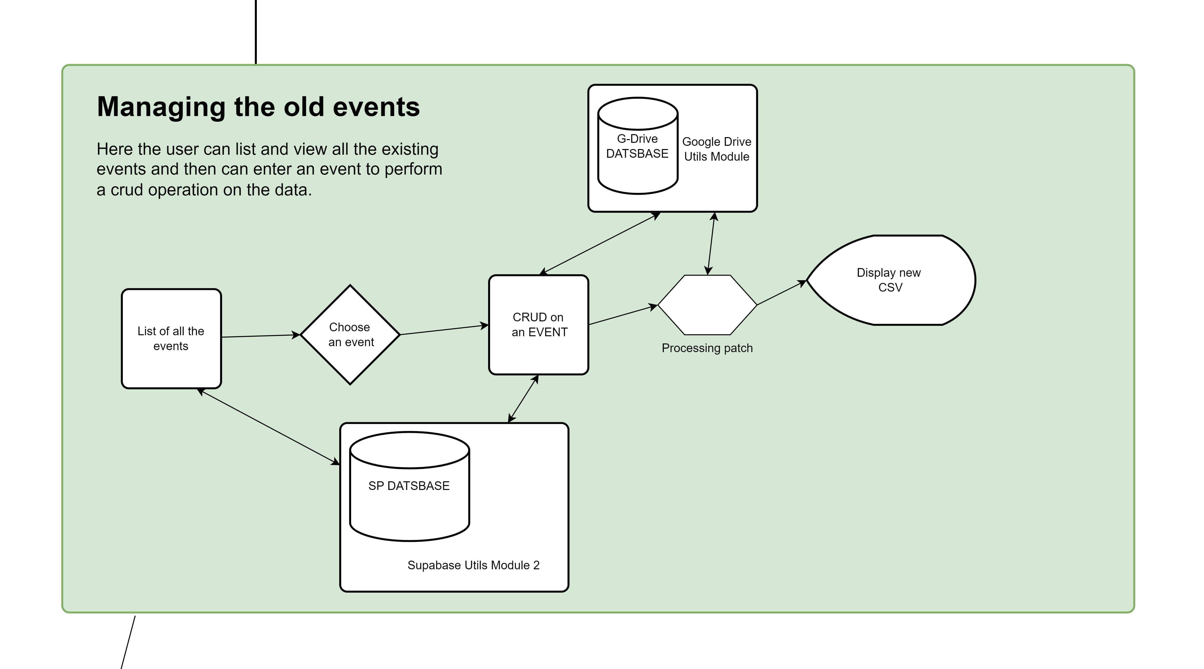
Manage Certification Events
Uni
cever

Slide 11
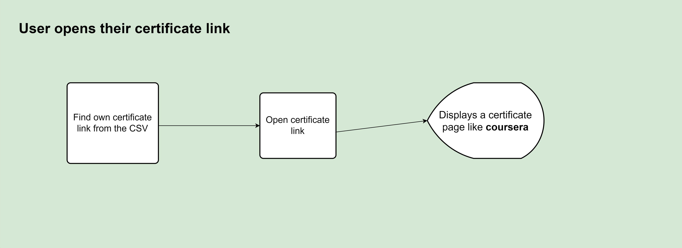
Certificate Issuance and Access
Uni
cever
Effortless Issuance: Generate certificates swiftly, providing a CSV file with unique links for hassle-free distribution.
Secure Access: Grant recipients secure access to digital certificates via unique links, ensuring reliable validation.
User Empowerment: Equip holders with control over their credentials, enabling efficient management, sharing, and utilization.

Slide 12

Future Scope
Uni
cever
Blockchain Integration: We can explore blockchain for heightened certificate security and immutability.
AI Verification: Implement AI to automate precise organization validation.
API Integration: Develop APIs for effortless system integration with diverse platforms.

Slide 13

Benefits and Outcomes
Credibility Boost: Ensure authentic certificates for enhanced trust.
Efficiency Gains: Save time and costs through automated processes.
Fraud Prevention: Combat fraud with secure validation measures.
User Convenience: Elevate user experience through accessible, shareable credentials.
Uni
cever

Slide 14
Conclusion
Uni
cever
Project Impact: `UNICEVER` stands as a groundbreaking solution, enhancing certificate credibility through streamlined verification and secure distribution. It redefines the certification landscape, fostering trust between institutions and recipients.
Future Assurance: With its focus on security, efficiency, and transparency, `UNICEVER` reshapes certificate authentication. As it evolves, this project promises to set new authenticity standards, revolutionizing digital credentials for the future.

Slide 15

Thank You!
Uni
cever

